Slide 1
FabLab-NKNU 高師大自造者基地
國立高雄師範大學 科技學院

Slide 2
Fab Charter (I)
What is a fab lab? Fab labs are a global network of local labs, enabling invention by providing access to tools for digital fabrication.
What's in a fab lab? Fab labs share an evolving inventory of core capabilities to make (almost) anything, allowing people and projects to be shared.
What does the fab lab network provide? Operational, educational, technical, financial, and logistical assistance beyond what's available within one lab.
Who can use a fab lab? Fab labs are available as a community resource, offering open access for individuals as well as scheduled access for programs
參考來源:美國麻省理工學院 fab.cba.mit.edu/about/charter

Slide 3
Fab Charter (II)
What are your responsibilities? Safety: not hurting people or machines Operations: assisting with cleaning, maintaining, and improving the lab Knowledge: contributing to documentation and instruction
Who owns fab lab inventions? Designs and processes developed in fab labs can be protected and sold however an inventor chooses, but should remain available for individuals to use and learn from.
How can businesses use a fab lab? Commercial activities can be prototyped and incubated in a fab lab, but they must not conflict with other uses, they should grow beyond rather than within the lab, and they are expected to benefit the inventors, labs, and networks that contribute to their success.
參考來源:美國麻省理工學院 fab.cba.mit.edu/about/charter

Slide 4
Maker Movement (I)
http://searchmanufacturingerp.techtarget.com/definition/Maker-movement
The maker movement is a cultural trend that places value on an individual's ability to be a creator of things as well as a consumer of things.
In this culture, individuals who create things are called "makers." Makers come from all walks of life, with diverse skill sets and interests. The thing they have in common is creativity, an interest in design and access to tools and raw materials that make production possible.
參考來源：TechTarget http://searchmanufacturingerp.techtarget.com/definition/Maker-movement

Slide 5
Maker Movement (II)
The growth of the maker movement is often attributed to the rise of makerspaces -- community centers where makers can go to access tools that would otherwise be inaccessible or unaffordable.
Peer education and opportunities for collaboration are important maker tools, as are access to digital fabrication tools such as 3D printers, laser cutters, CAD software and computer numerical control (CNC) milling machines.
While the majority of makers are hobbyists, entrepreneurs and small manufacturers are also taking advantage of the classes and tools available in makerspaces.
參考來源：TechTarget http://searchmanufacturingerp.techtarget.com/definition/Maker-movement

Slide 6
Maker Movement (III)
The maker movement is international, promoted by magazines, conventions, video channels and Web-based marketplaces.
The movement is growing rapidly and is expected to be economically disruptive; as ordinary people become more self-sufficient, they will be able to make their own products instead of purchasing brand-name products from a big box store.
In the United States, the maker movement has been promoted by the government as a way to encourage students to become more interested in STEM (science, technology, engineering and math) and as a way for ordinary citizens to revitalize manufacturing.
參考來源：TechTarget http://searchmanufacturingerp.techtarget.com/definition/Maker-movement

Slide 7
STEM (I) Science/Technology/Engineering/Mathematics
http://www.ed.gov/stem
The United States has developed as a global leader, in large part, through the genius and hard work of its scientists, engineers, and innovators.
In a world that’s becoming increasingly complex, where success is driven not only by what you know, but by what you can do with what you know, it’s more important than ever for our youth to be equipped with the knowledge and skills to solve tough problems, gather and evaluate evidence, and make sense of information.
These are the types of skills that students learn by studying science, technology, engineering, and math—subjects collectively known as STEM.
Yet today, few American students pursue expertise in STEM fields—and we have an inadequate pipeline of teachers skilled in those subjects. That’s why President Obama hasset a priority of increasing the number of students and teachers who are proficient in these vital fields.
參考來源：美國教育部官網www.ed.gov/stem

Slide 8
STEM (II) Science/Technology/Engineering/Mathematics
All young people should be prepared to think deeply and to think well so that they have the chance to become the innovators, educators, researchers, and leaders who can solve the most pressing challenges facing our nation and our world, both today and tomorrow.
President Obama has articulated a clear priority for STEM education: within a decade, American students must "move from the middle to the top of the pack in science and math." The Obama Administration also is working toward the goal of fairness between places, where an equitable distribution of quality STEM learning opportunities and talented teachers can ensure that all students have the chance to study and be inspired by science, technology, engineering, and math—and have the chance to reach their full potential.
參考來源：美國教育部官網www.ed.gov/stem

Slide 9
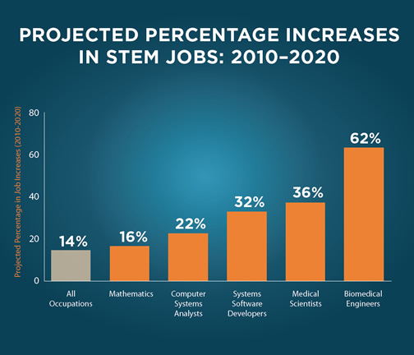
STEM (III) Science/Technology/Engineering/Mathematics
參考來源：美國教育部官網www.ed.gov/stem

Slide 10
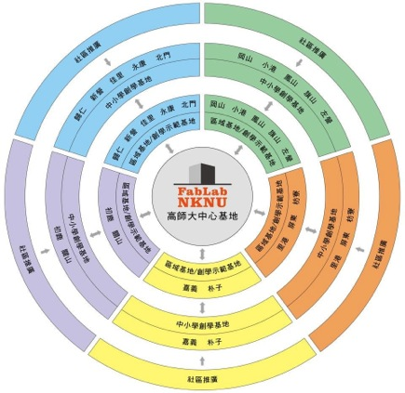
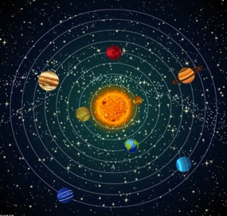
教育部推動創新自造教育改進計畫 師資培育大學自造者基地建置計畫
FabLab-NKNU高師大自造者基地 太陽系星球運作模式深耕偏鄉地區
中心（恆星）基地 （1）
區域（行星）基地 (20) 講師(60)
衛星學校 (200)
種子教師 (400)
創學（衛星）基地 (7)

Slide 11
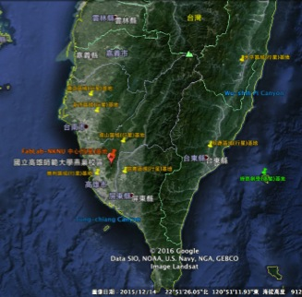
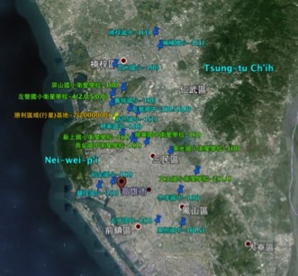
FabLab-NKNU高師大自造者基地 區域基地分布圖及衛星學校分布圖
中心基地所屬區域基地分布圖
勝利區域基地所屬衛星學分布圖

Slide 12
Maker 應具備的基本技術
傳統輔助自造技術
數位輔助自造技術
數位控制技術
3D繪圖建模能力

Slide 13
師資及學生Maker培訓模式 Learning by Doing
修繕物品/客製化需求/創意創新/樣品原型
手繪草圖能力/2D, 3D 繪圖建模能力
功能需求及技術能力分析清單
設備需求及操作能力分析清單
修繕及客製化（問題解決導向學習）
團隊分工學習及系統整合（專案創新導向學習）

Slide 14
中小學Maker教育推動的瓶頸和問題 目前現況
中小學對Maker教育的定義及方向不清楚
中小學再Maker師資人數及技術能量不足
中小學在Maker師資之培訓無機制及標準
中小學無適當時段排課，以前都自然發展
中小學無經費及能力建置自造教室及設備
中小學無適當自造教育之教具及教材教法
中小學急於尋找發展方向跟上107年新課綱

Slide 15
高師大自造者基地協助中小學 推動自造教發展策略（Ｉ）
基地建置示範
設備規格、性能、詢價、評估、試用、採購及標案規格制定
中心基地在各縣市與中小學合作建置區域基地培訓衛星學校教師
中心基地協助衛星學校建置創學衛星基地
中心基地開發超低價位開源『自造技術教學（學習）平台』
中心基地開發自造技術教具教案之『教師手冊及學生手冊』
創學衛星基地學校及學生作為新教材示範及實驗教學場域及對象

Slide 16
高師大自造者基地協助中小學 推動自造教發展策略（ＩＩ）
培訓四大類自造技術
傳統輔助自造技術
數位輔助自造技術
數位控制及物聯網技術
3D繪圖及建模技術
建立創意實現之系統整合能力
「自造技術輔助教學（學習）平台」串聯四大類技術輔助學習

Slide 17
FabLab-NKNU高師大自造者基地 執行策略
中小學自造教育/深耕/扎根/定根
培訓種子教師自造技術為核心目標
只教中小學買得起的設備
課程圖書館方便偏鄉遠距學習
以臉書及網站建立自造者社群
資料庫分析種子教師培訓成效

Slide 18
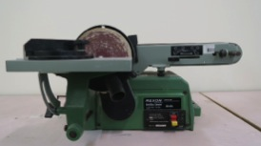
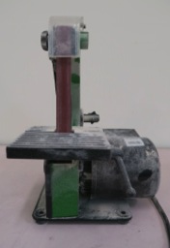
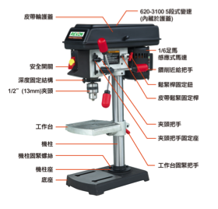
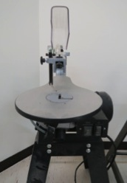
傳統輔助自造設備

Slide 19
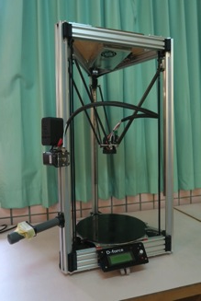
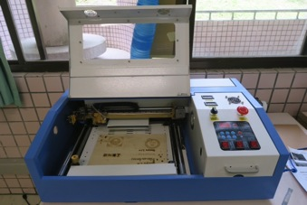
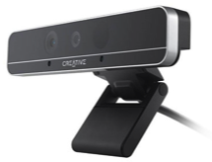
數位輔助自造設備
3D 列印機
鐳射切割機
3D掃描器

Slide 20
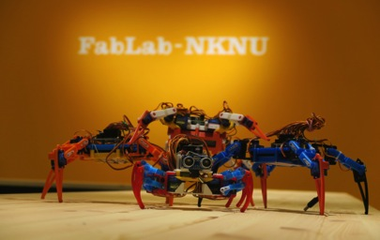
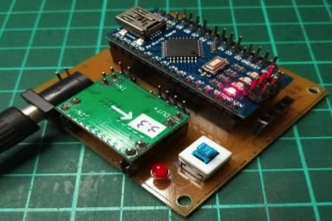
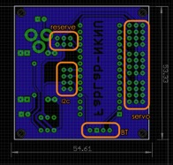
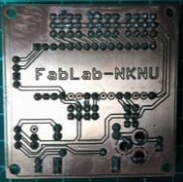
自造技術輔助教學（學習）平台

Slide 21
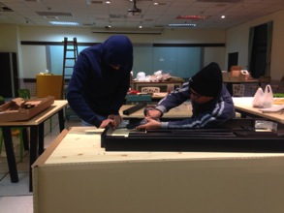
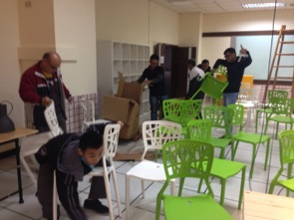
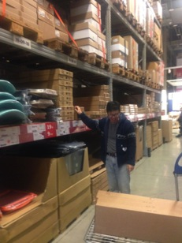
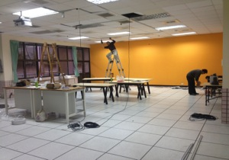
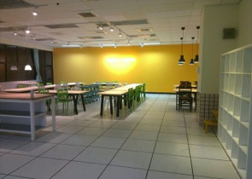
FabLab-NKNU高師大自造者基地的建置 ＤＩＹ的精神建設基地

Slide 22
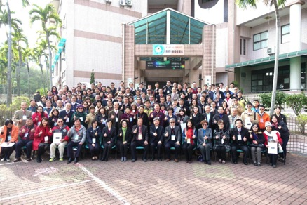
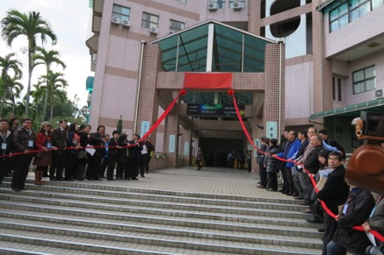
FabLab-NKNU高師大自造者基地 揭牌啓用儀式

Slide 23
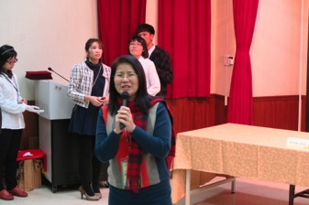
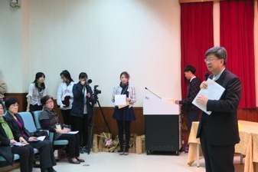
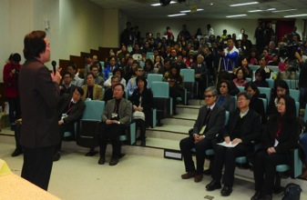
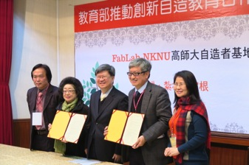
FabLab-NKNU高師大自造者基地 五縣市局處及200所學校策略聯盟簽約

Slide 24
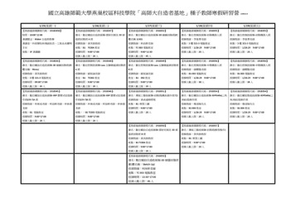
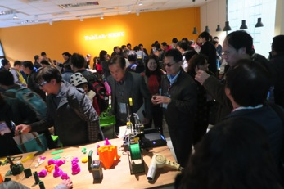
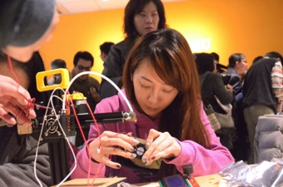
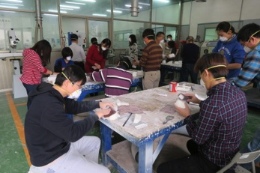
FabLab-NKNU高師大自造者基地 五天密集中小學種子教師營隊

Slide 25
FabLab-NKNU高師大自造者基地 中心基地及區域基地開課及時數規劃
(1)中心(恆星)基地
負責「高階自造技術及跨域整合自造技術」之「週末工作坊」共12日次84小時，「寒、暑假5日密集研習營」共10日次70小時。
(2)區域(行星)基地
區域基地需輔導10所衛星學校及至少20位會員教師。每個區域基地一年至少要開12日次共84小時的4大類技術之「基礎技術普及工作坊」及「自造技術應用工作坊」。
(3)創學(衛星)基地
無法得到區域基地支援輔導的偏鄉學校，中心基地將特別協助成立7個偏鄉學校之「創學(衛星)基地」，直屬中心基地支援，除借用自造設備，並派資深講師至衛星基地與種子教師協同教學。

Slide 26
FabLab-NKNU高師大自造者基地 自造技術培訓規劃
(1)3D繪圖及建模技術(123D、Sketch up、 Thinkercad、Rhino)
(2)數位輔助自造技術(3D列印、3D掃描、鐳射切割及雕刻、3D摺
紙、3D拼圖......)
(3)數位控制技術(數控系統輔助教學平台之情境式教學：3D掃描＋3D列印＋平台、
Scratch+平台、雷切＋平台、木工＋平台、Sensor+Scratch+平台、Makey Makey)
(4)傳統輔助自造技術(線鋸機+砂磨機+鑽床機具操作、木工＋數控平台，動物模型及書
架製作......)
(5)自造技術融入學科教具製作及應用，自造技術融入科展之作品製作及應用，自造技
術融入競賽之作品製作及應用
(6)資深Maker教師精進高階技術研習專班
(7)社群教師參與『創學示範基地』自造課程學生端協同教學及觀摩

Slide 27
FabLab-NKNU高師大自造者基地 課程開發(20門）
3D掃描＋3D/2D轉檔＋鐳射雕刻＝3D摺紙
3D繪圖/3D掃描＋3D分層＋鐳射切割＝3D拼圖
3D繪圖/3D掃描＋3D分層＋線鋸機＝3D拼圖
數控平台＋3D掃描建模＋3D列印＝修理缺腳
數控平台＋3D繪圖＋3D列印=創新結構造型
數控平台＋木工設備＝放大仿生結構
數控平台＋ Scratch積木程式＝學習程式控制

Slide 28
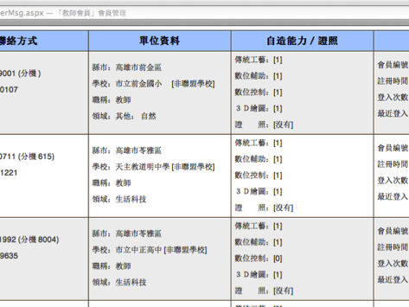
FabLab-NKNU高師大自造者基地 學員培訓技術能力管考
會員報名課程研習時，報名後台管理系統即開始記錄學員該次課程的各項歷程記錄，包括：技術屬性、技術等級、課程代碼、課程名稱 、課程綱要、出席狀況、教學滿意度、作業上傳等8項管考資訊。當同一類技術屬性，同一技術等級，不同課程代碼修滿3次，該學員自造能力的該項技術屬性的技術能力即晉一級。

Slide 29
FabLab-NKNU高師大自造者基地 歡迎加入臉書社團
自造者基地臉書公開社團 自造者基地臉書 中小學教師共備社群臉書社團

Slide 30
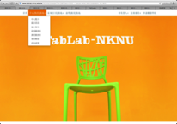
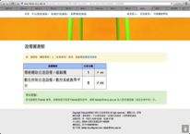
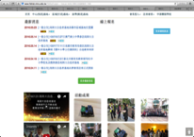
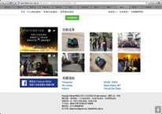
FabLab-NKNU高師大自造者基地 歡迎進入網站註冊會員申請聯盟學校
網站首頁 中心基地簡介 設備圖書館及課程圖書館 最新公告及線上報名 活動花絮及相關連接
FabLab-NKNU網站提供會員遠距教學服務及區域基地和衛星基地活動花絮分享之共用平台
www.fablab.nknu.edu.tw

Slide 31
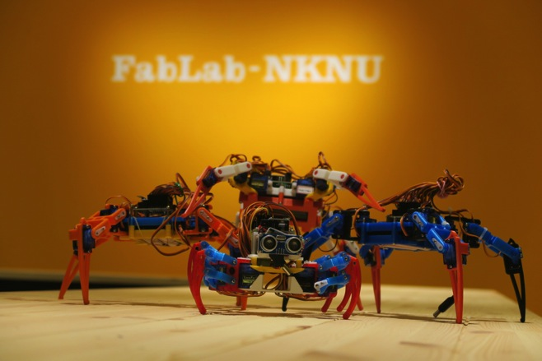
FabLab-NKNU高師大自造者基地 感謝您的聆聽

